Slide 1


TDD Approach for Customer Customization
This presentation will explore Test-Driven Development (TDD) for enhancing customer customization in a Java project. We will focus on writing tests for customer order customization and price calculation based on condiments used.

Slide 2

Importance of Testing in Customer Customization
1
User Satisfaction
Thorough testing ensures that customer customizations are implemented correctly and meet their expectations, leading to increased satisfaction and positive user experiences.
2
Reduced Bugs
By writing tests before writing code, we can identify and prevent potential errors early on, reducing the chances of encountering unexpected issues in production.
3
Faster Development
TDD encourages a more iterative and focused approach to development, leading to quicker delivery of features and a more efficient development process.
4
Code Quality
Writing tests helps ensure that the code is well-structured, modular, and maintainable, contributing to a higher overall quality of the application.

Slide 3
Writing Tests for Customer Order Customization
Test Cases
Assertions
Mocking
Create test cases that cover all possible scenarios for customer customizations, such as selecting different ingredients, adding extra toppings, or modifying existing options.
Use assertion methods to verify that the expected behavior of the code is achieved. Assertions ensure that the customizations are correctly applied and the order details are updated accordingly.
Use mocking techniques to isolate and test specific components of the customization logic without relying on external dependencies or real-world data.
Adding a specific condiment
Removing a condiment
Changing the quantity of a condiment

Slide 4
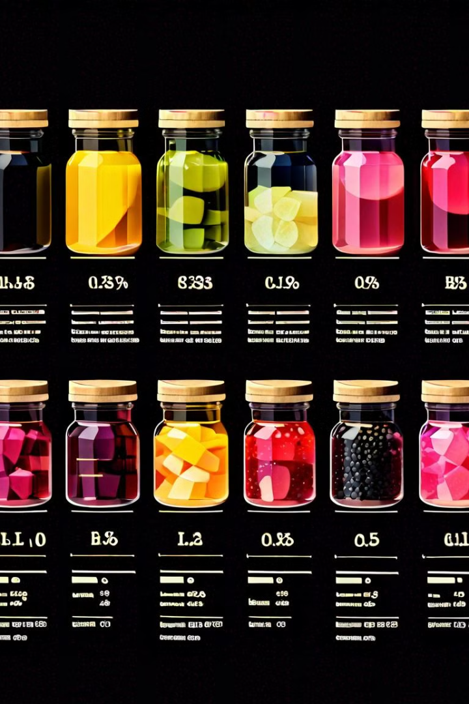
Calculating Price Based on Condiments Used
Condiment
Price
Ketchup
$0.25
Mustard
$0.20
Relish
$0.30
Mayo
$0.35

Slide 5




Implementing TDD for Price Calculation
Test 1
Test 2
Test 3
Write a test that asserts the price is correct for a base order with no condiments.
Write a test that asserts the price is correct for an order with a single condiment.
Write a test that asserts the price is correct for an order with multiple condiments.

Slide 6

Handling Edge Cases and Error Scenarios
Invalid Input
Write tests that handle invalid input, such as incorrect condiment names or quantities, ensuring that the code gracefully handles these situations and provides appropriate feedback to the user.
Missing Data
Write tests to handle situations where certain data may be missing or incomplete, such as missing prices for specific condiments, and ensure that the application behaves as expected.
Unexpected Behavior
Write tests to address scenarios where the code might exhibit unexpected behavior, such as a negative price or an invalid order total, ensuring that appropriate error handling mechanisms are in place.

Slide 7




Integrating TDD with the Java Project
Build System
Test Framework
Continuous Integration
Integrate TDD with your build system (e.g., Maven, Gradle) to automate the execution of tests during the build process, ensuring that the code is tested consistently and thoroughly.
Choose a suitable Java test framework (e.g., JUnit, TestNG) to write and execute your tests, providing a robust and flexible environment for testing your application.
Integrate your tests with a continuous integration system (e.g., Jenkins, Travis CI) to run tests automatically on every code change, providing rapid feedback and early detection of potential issues.

Slide 8

Conclusion and Key Takeaways
By embracing TDD principles, we can significantly improve the quality, maintainability, and reliability of our Java application. It's a crucial practice for delivering user-centric and robust software solutions.

